Slide 1
CSE5007 EXPLORATORY DATA ANALYSIS – EMBEDDED PROJECT
EXPLORATORY DATA ANALYSIS ON Airline Fatalities USING PYTHON
TEAM MEMBERS UNDER THE Supervision OF
SNEHA Yadav (21MDT0028)
Divye gupta (21MDT0063) DR. RUSHIKUMAR B
Abhay Singh bajirao patil (21MDT0075) ASSOCIATE PROFESSOR SR.. SAS

Slide 2
Objective:
An attempt to determine the plane types where the most airline incidents occurred.
We tried to identify which airlines are more likely to experience incidents and have a higher death toll.
Finding possible patterns behind the number of fatalities and incidents.

Slide 3
Abstract:
A lot of air incidents are happening in these days due to which many fatalities can be seen and this became an inspiration of our project.
In this project we try to find various patterns and relations behind the airline fatalities.
From our work the airlines can benefit by taking more precautions against the factors due to which more number of fatalities occured.
From our work, we can help the airlines take more precautions against the factors that contributed to more fatalities.
Key Words: Aircraft Operators, Casualties, Fatalities.

Slide 4
INTRODUCTION:
Airline Incident is an occurrence associated with the operation of an aircraft that affects or could affect the safety of operation.
Such incidents are increasing day by day due to n number of reasons, so we try to analyse few of them so as to help in bringing reduction of fatalities arising due to such incidents.
We try to find patterns amongst the already occurred incidents dated between 2nd August 1919 and 15th February 2022.
We use Python because it is a very robust language and contains wide variety of modules and packages which makes analysis much more easy process.
In the data we couldn’t visualize all the aircraft operators as the total number was very big. So, we just considered those Aircraft Operators where Total Fatalities were above 500.

Slide 5
PROBLEM DEFINITION
We Try to Find :-
which aircraft type faced the highest number of incidents and fatalities, like Domestic Passenger, Cargo, Military etc.
The Aircraft Phase where most number of Fatalities occurred.
Number of Fatalities depending upon the damage of the Aircraft.
The aircraft operators linked with the most number of incidents and Fatalities.
The Number of Fatalities corresponding to each month.
The Number of Fatalities corresponding to each Date.
The Number of Fatalities corresponding to each Day of the Week.

Slide 6
Research Methodology
In this project, We have taken the secondary data as a part of our research. So we assume that this data is verified and authenticated. The Data has been taken from Kaggle.
We used Python Jupyter Notebook to carry out the analysis as it one of the best available tools to do Data Analysis.
Specifically we used numpy, pandas, seaborn and matplotlib packages of python.
We imported the Data and carried out the pre-processing like cleaning the data, removing/treating outliers and made it ready for the analysis.
We further grouped the data on various features like aircraft types, aircraft operators and so on, and summed up all the Fatalities.
Then, we used multiple number of bar plots and line plots to find patterns and relations amongst these grouped attributes of the features.

Slide 7
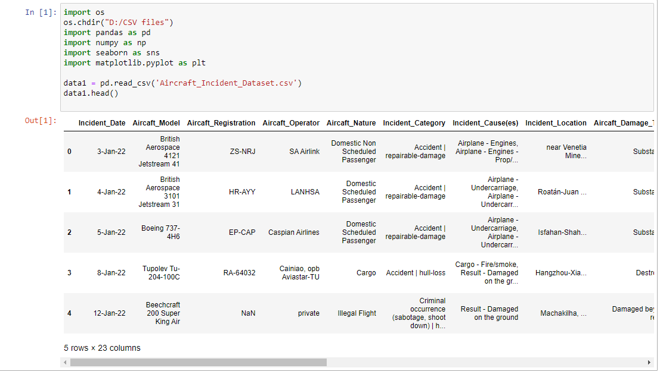
TECHNICAL SPECIFICATIONS & CODES
Firstly we imported our CSV Data as a Data Frame in our Jupyter Notebook file. The Data included 23,519 Incidents, which occurred between the dates 2nd August 1919 and 15th February 2022.

Slide 8
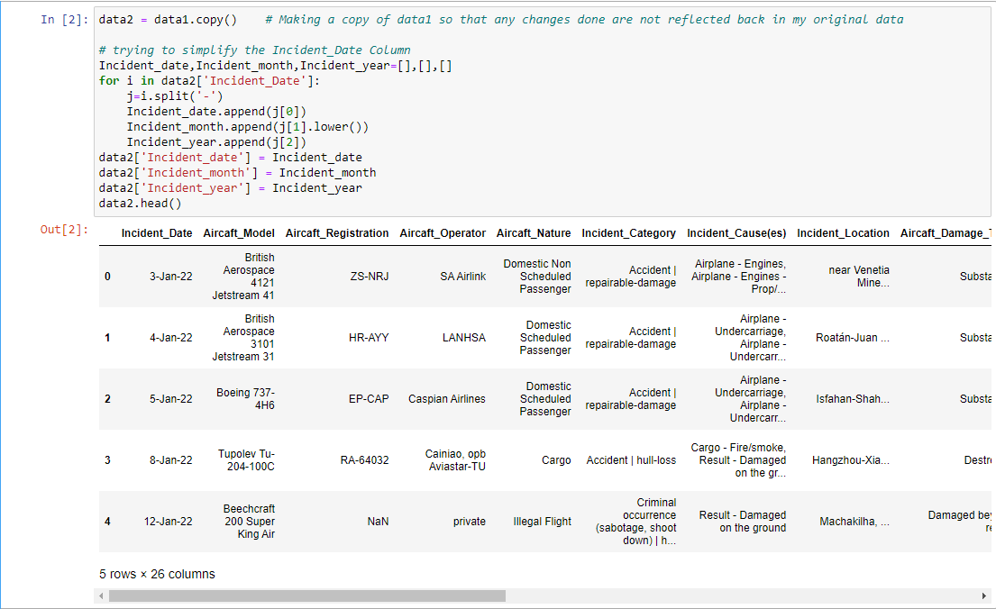
Technical Specifications Cont.
We split up the ‘Incident Date’ into three different features as ‘Incident_Date’, ‘Incident_Month’ and ‘Incident_Year’.

Slide 9
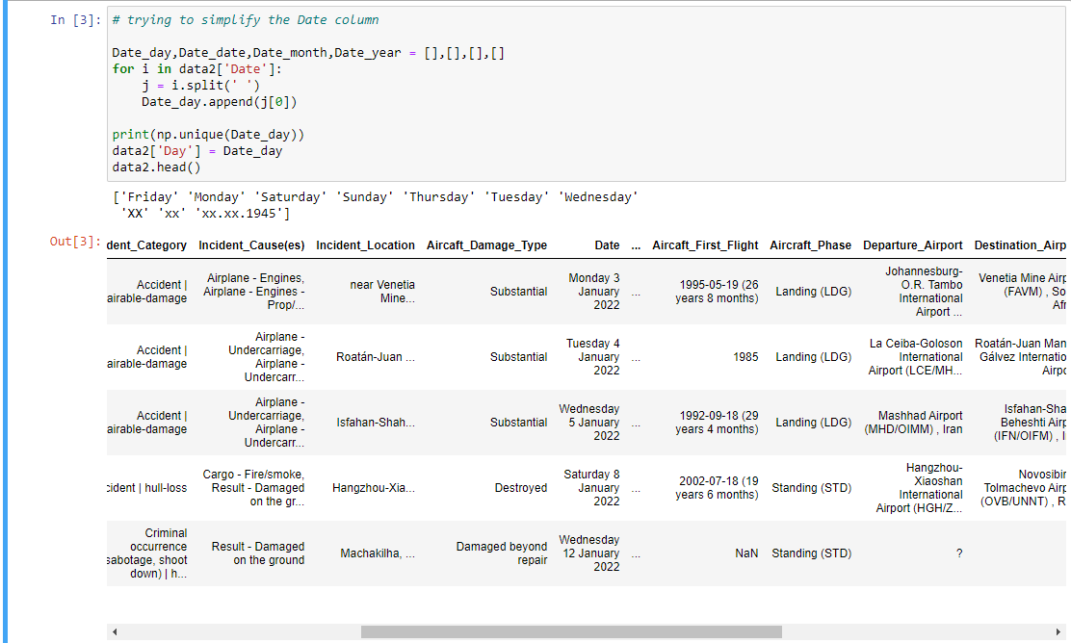
Technical Specifications Cont.
And from the ‘Date’ column we split up to get a ‘Day’ feature

Slide 10
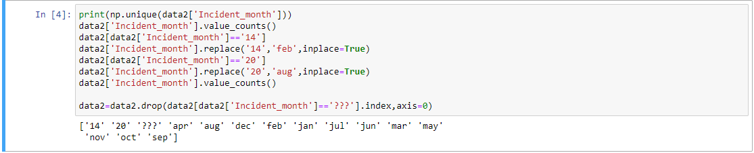
Technical Specifications Cont.
The ‘Incident Month’ Column had some weird elements and on clearly seeing the immediate previous and the immediate next element, we replaced it with the same value if the previous and the following values were same. And removed the rows which contained some other values.
Same was carried out for ‘Incident_Date’ and ‘Day’ Column.
And, Finally the data was now ready for Visualizations.

Slide 11
Visualizations and Discussions

Slide 12
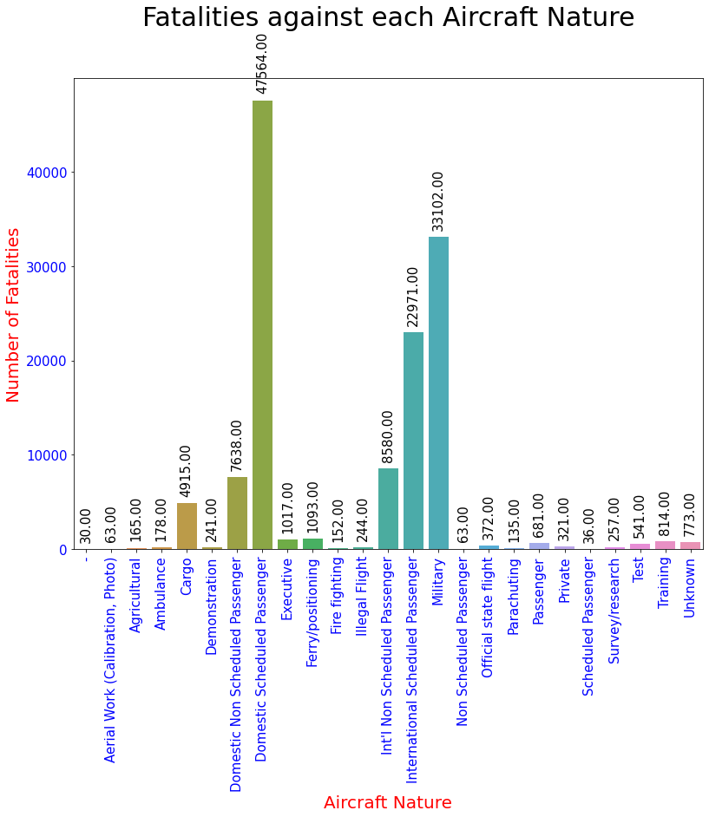
Fatalities Against Each Aircraft Nature
We are trying here to display the Number of Fatalities based on the nature of the aircraft whether it be a commercial, cargo or military aircraft.
We can ascertain from the graph above that most passengers were killed in domestic scheduled passenger aircraft followed by military aircraft.

Slide 13
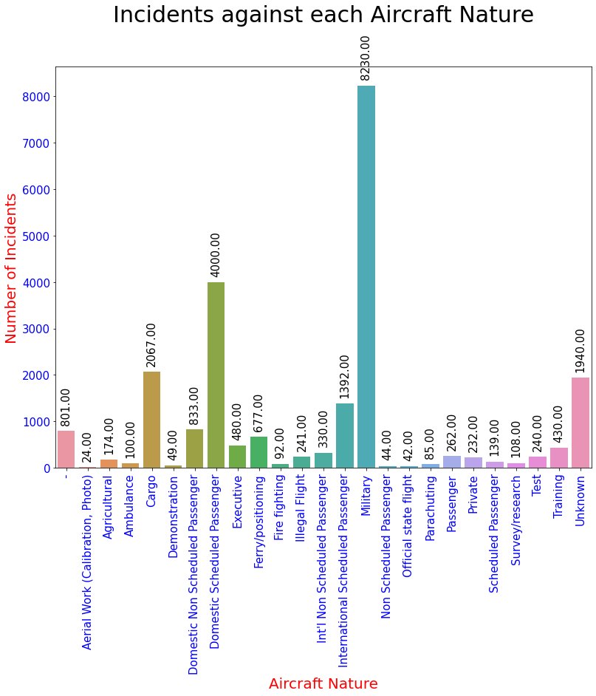
Incidents Against Each Aircraft Nature
In this graph, we have attempted to display the Number of incidents based on the type of aircraft, whether it be a commercial, cargo, or military aircraft.
As we can see from the graph, most incidents occurred with military aircraft.
In light of the graph above, we can conclude that military type aircraft have fewer fatalities than domestic scheduled passenger aircraft, but have more incidents.

Slide 14
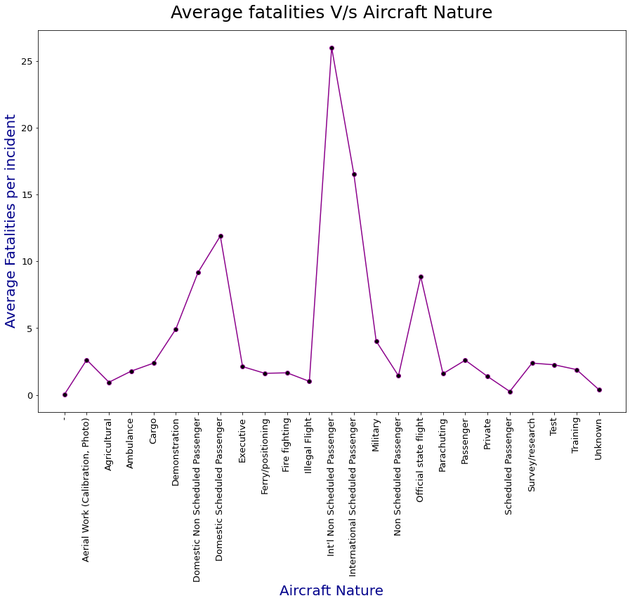
Average Fatalities V/S Aircraft Nature
Based on the type of Aircraft Nature, we have attempted to display the average number of fatalities per incident.
By examining this scatter plot, we can conclude that the average fatality occurs in International Non-Scheduled Passenger Aircrafts.
Non-scheduled passenger aircraft are probably the biggest victims of terrorist hijackings.
As stated, this is more focused on non-scheduled passenger airliners, which are probably a bigger cause of hijackings by terrorists.

Slide 15
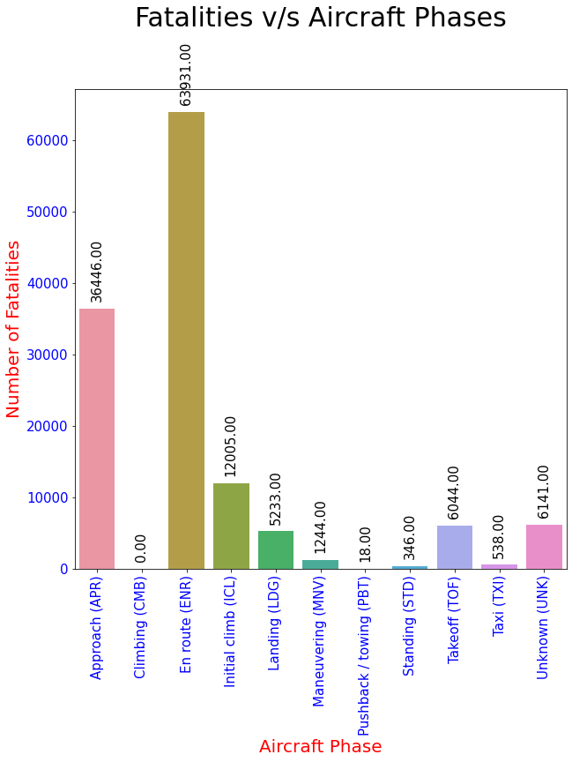
Fatalities V/S Aircaft Phases
According to the type of aircraft phase, we have attempted to display the Number of fatality.
In analysing this Bar plot, we can determine that the Number of fatality occurs during the approach phase, during the initial climb phase, and during the En route phase.

Slide 16
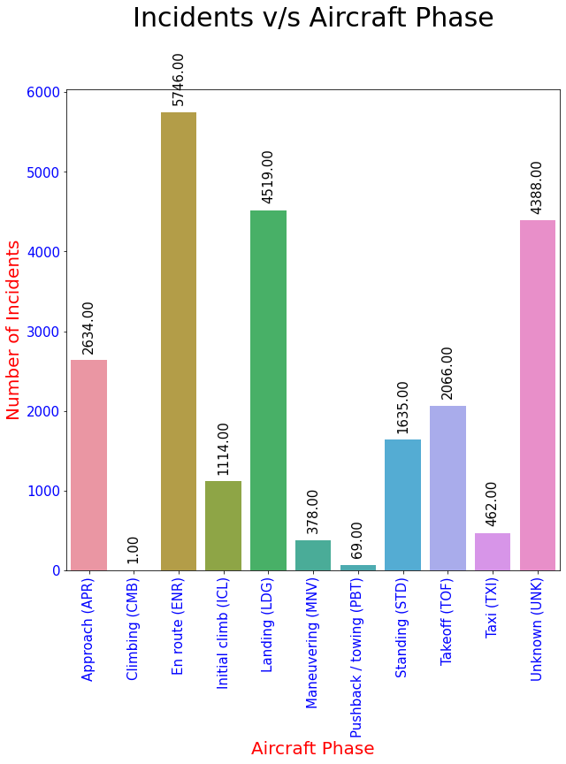
Incident V/S Aircaft Phase
This following chart illustrates which Aircraft Phase has the highest incidence of aircraft incidents.
Here we can visualize that Number of incidents while the Aircraft is in En Route phase is pretty high followed by Landing Phase and Unknown phase

Slide 17
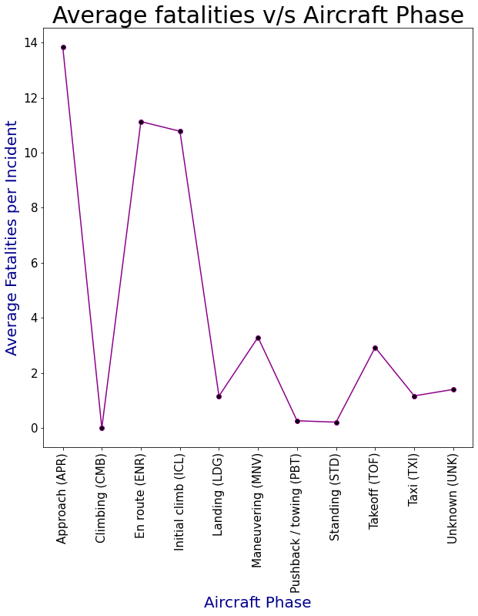
Average Fatalities V/S Aircarft Phase
According to the type of aircraft phase, we have attempted to display the average fatality per incident.
In analyzing this scatter plot, we can determine that the average fatality occurs during the approach phase, during the initial climb phase, and during the En route phase.

Slide 18
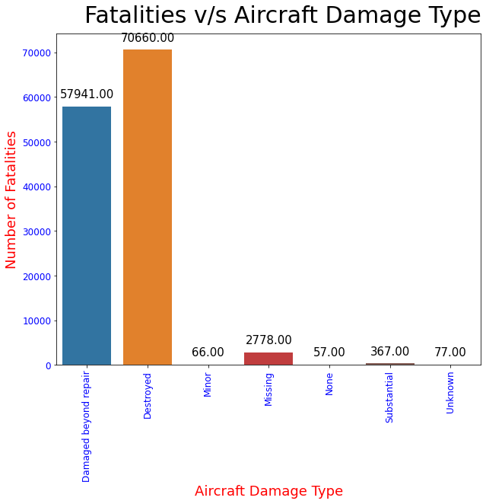
Fatalities V/S Aircaft Damage Type
For each type of Aircraft Damage, we have attempted to display the fatality count.
Our conclusion is that when DESTROYED is the damage type of aircraft, the fatalities are pretty high compared to any other type of damage.
Our conclusion is that when an aircraft's damage type is "DESTROYED," the number of fatalities is pretty high.
As when the Aircraft gets destroyed it’s a very rare chance of survival of the passengers

Slide 19
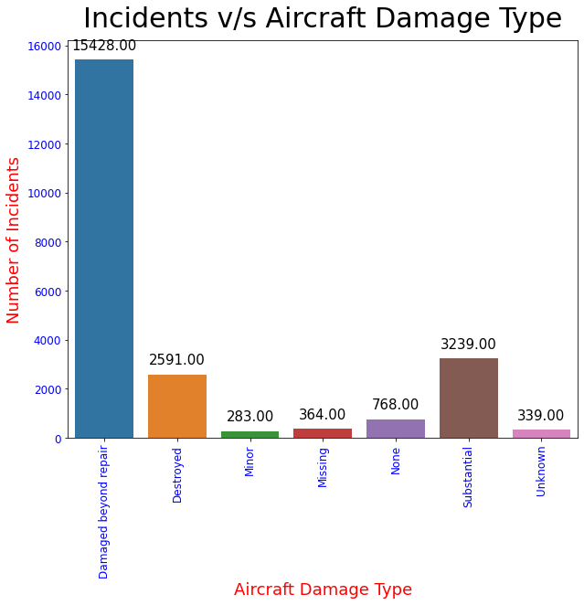
Incidents V/S Aircraft Damage Type
For each type of Aircraft Damage, we have attempted to display the incident count.
Our conclusion is that when ” DESTROYED BEYOND REPAIR “ is the damage type of aircraft damage, the incidents are pretty high compared to any other type of damage.
Our conclusion is that when an aircraft's damage type is "DESTROYED BEYOND REPAIR" the number of incidents is pretty high.

Slide 20
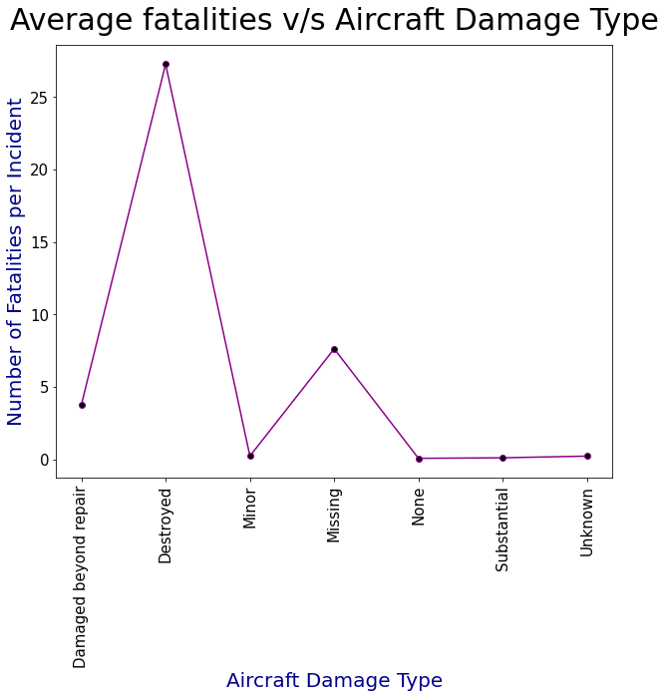
Avg Fatalities V/S Aircraft Damage Type
For each type of Aircraft Damage, we have attempted to display the fatality count by incident.
Our conclusion is that when DESTROYED is the damage type of aircraft, the fatalities are pretty high compared to any other type of damage.
Our conclusion is that when an aircraft's damage type is "DESTROYED," the number of fatalities is pretty high.

Slide 21
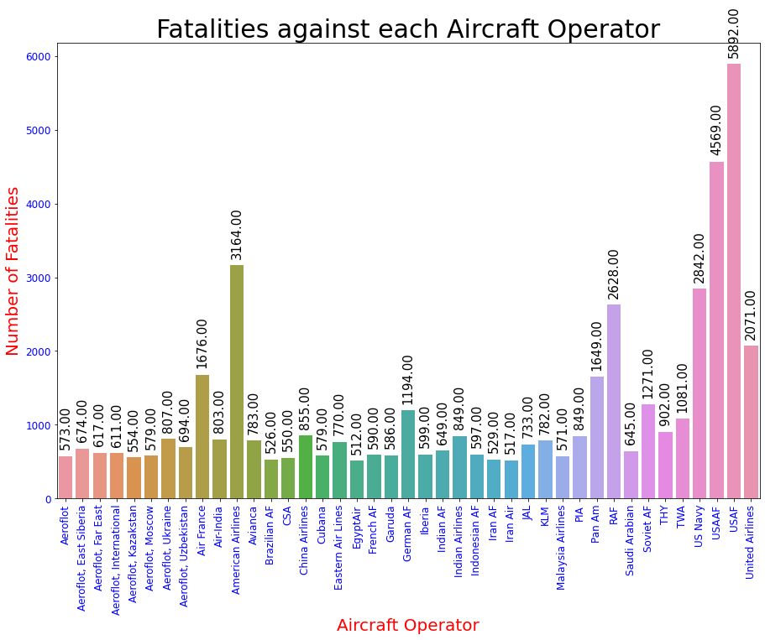
Fatalities against each Aircraft Operator
According to the type of aircraft operator, we have attempted to display the number Fatalities.
In Analysing this Bar plot, we can determine that the number of incident are pretty high in USAF(United states Air Force ).
In light of the graph above, we can conclude that USAF type aircraft have fewer incidents than USAAF aircraft, but have more fatalities

Slide 22
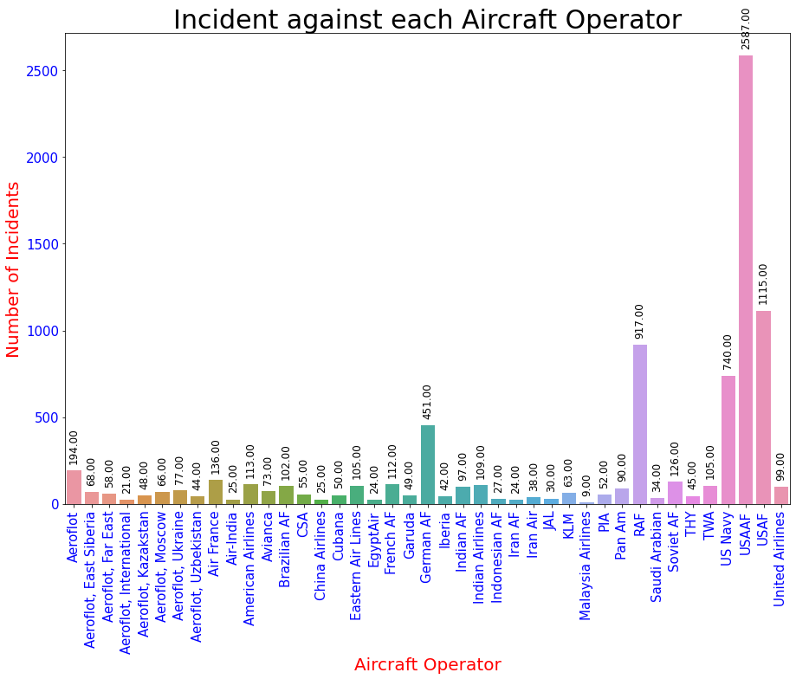
Incidents against each Aircraft Operator
According to the type of aircraft operator, we have attempted to display the number incident.
In Analysing this Bar plot, we can determine that the number of incident are pretty high in USAAF(United states Army Air Force ).
Following may the reasons for the Cause of USAAF Airline Incidents:-
Due to Training
Due to Human Error
Due to Missile training

Slide 23
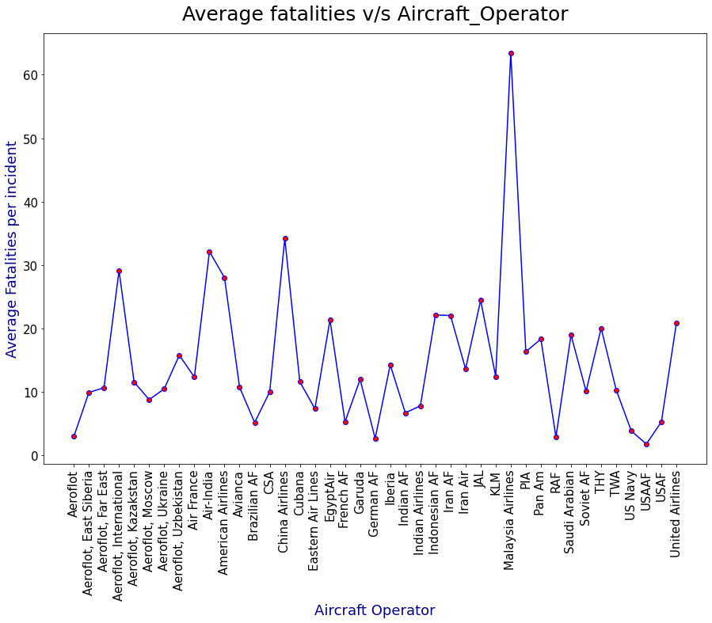
Avg Fatalities V/S Aircraft Operator
According to the type of aircraft operator, we have attempted to display the average fatality per incident.
In Analysing this scatter plot, we can determine that the average fatality occurs by the Malaysia Airlines.
Following may the reasons for the Cause of Malaysian Airline Incidents:-
Bad weather
Pilot error
Mechanical Failure

Slide 24
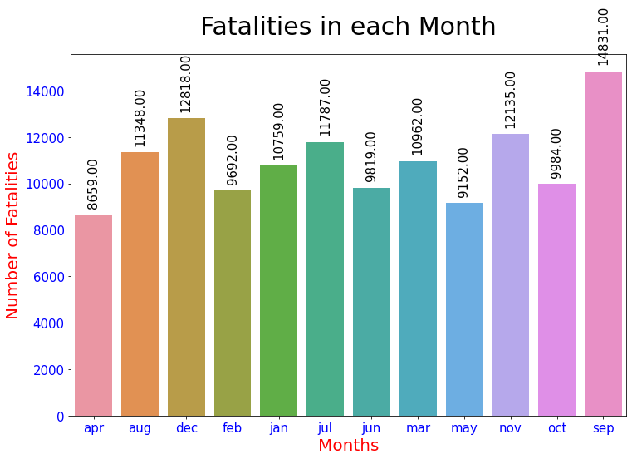
Fatalities in Each Month
Based on the Which Month, we have attempted to display the number of fatalities per incident.
As evident from this Bar plot, the majority of fatalities occur in the months of November and September and December due to bad weather as these two months have pretty bad weather conditions in this part of the year.
Reasons:-
Iceing due to the cold weather
The Fogg in the winter days

Slide 25
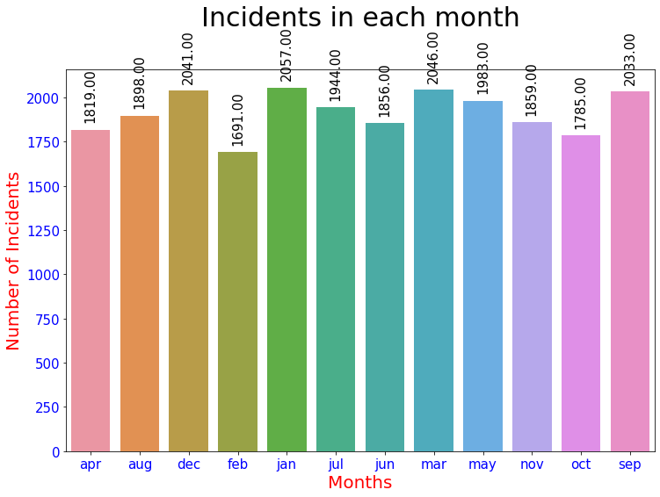
Incidents in Each Month
This following chart illustrates which month of the year has the highest incidence of aircraft accidents.
In conclusion, we can see that there is no particular difference between the number of incidents per month but we can gradually see that there are more incidents in the months of December/September/January.

Slide 26
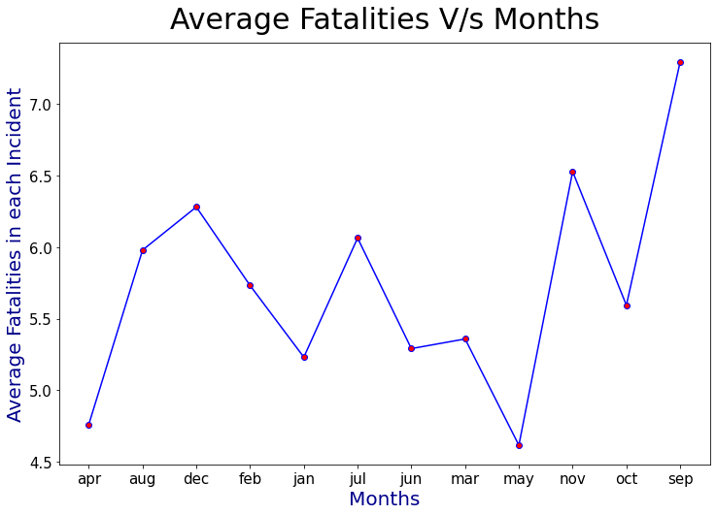
Average Fatalities V/S Months
Based on the type of Month, we have attempted to display the average number of fatalities per incident.
As evident from this scatter plot, the majority of fatalities occur in the months of November and September due to bad weather as these two months have pretty bad weather conditions in this part of the year.

Slide 27
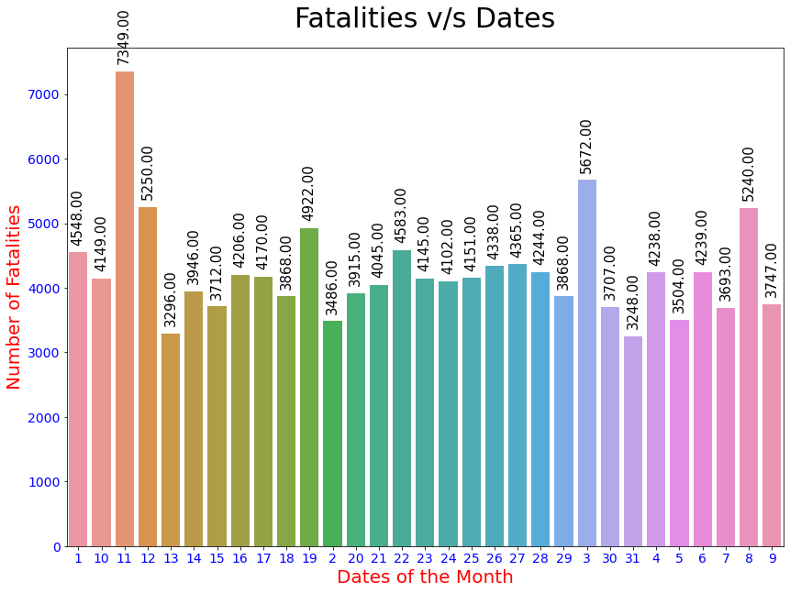
Fatalities V/S Dates
Based on the type of Date of the Month, we have attempted to display the Number of fatalities.
By examining this Bar plot, we can conclude that the average fatality occurs in the second week of a month, or exactly from 10th to 13th.

Slide 28
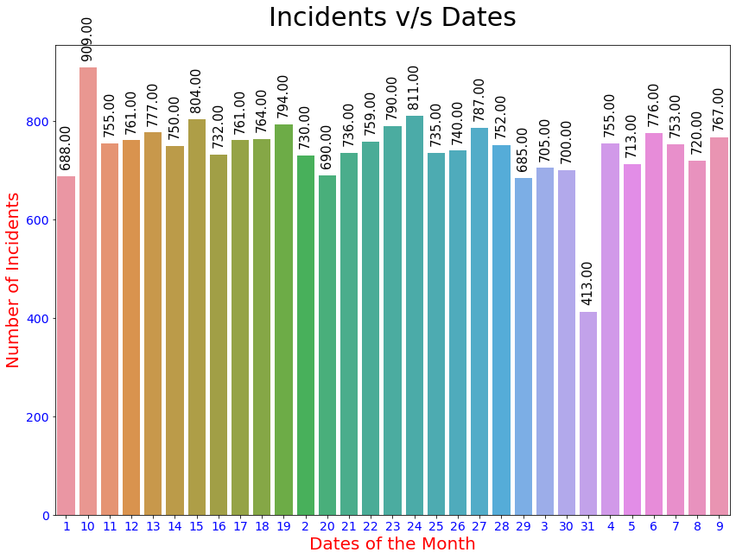
Incidents V/S Dates
In this following Bar Chart, we enlighten that which Dates of the month of is verry peak for Number of Incidents
And as we can conclude that there is no particular difference between number of incidents per Date here but we can gradually see that the incidents on the Date of 31st of every Month are less than the other Dates.
And Most incidents occur on the 10th of every month which is probably a start of the month.

Slide 29
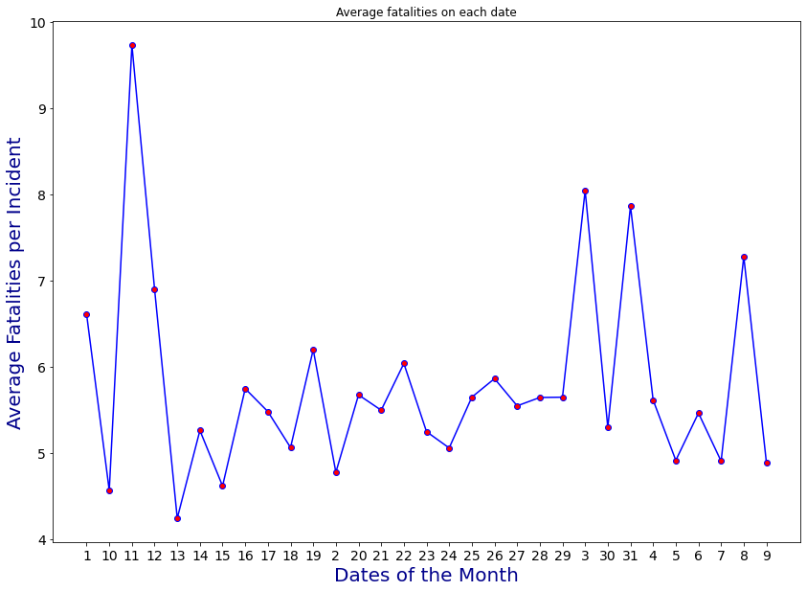
Average Fatalities on Each Date
Based on the type of Date of the Month, we have attempted to display the average number of fatalities per incident.
By examining this scatter plot, we can conclude that the average fatality occurs in the second week of a month, or exactly on 11th.

Slide 30
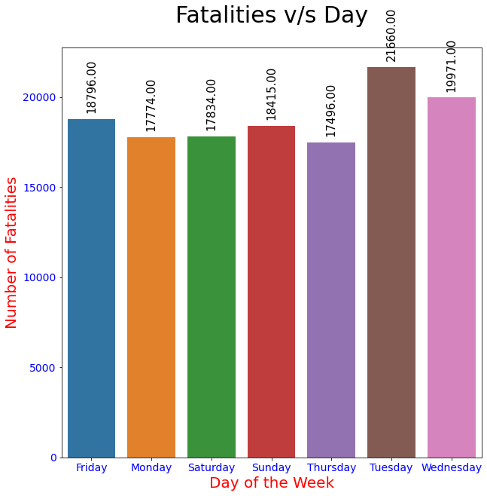
Fatalities V/S Day
Based on the type of Date of the Week, we have attempted to display the Number of fatalities.
By examining this Bar plot, we can conclude that the Number of fatalities is very high on the Tuesday

Slide 31
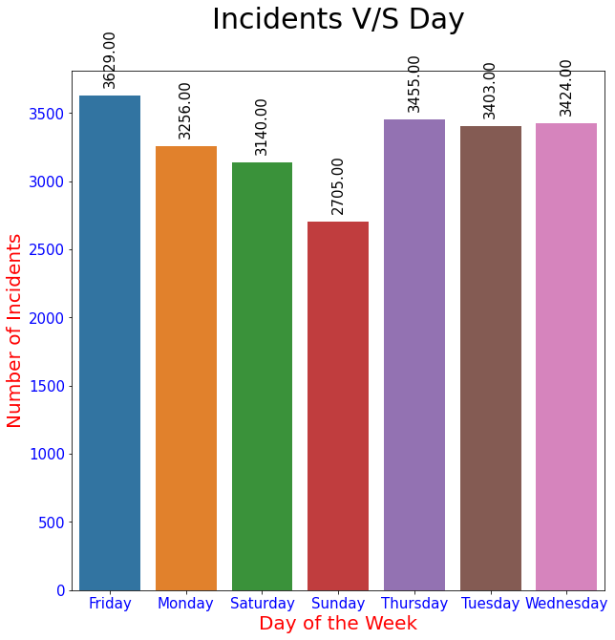
Incidents V/S Day
Based on the type of Date of the Week, we have attempted to display the Number of fatalities.
Based on the Bar plot, it appears that the number of incidents does not follow any upward or downward trend. In addition, Sunday is the only day when number of incidences are lower than the other days of the week.

Slide 32
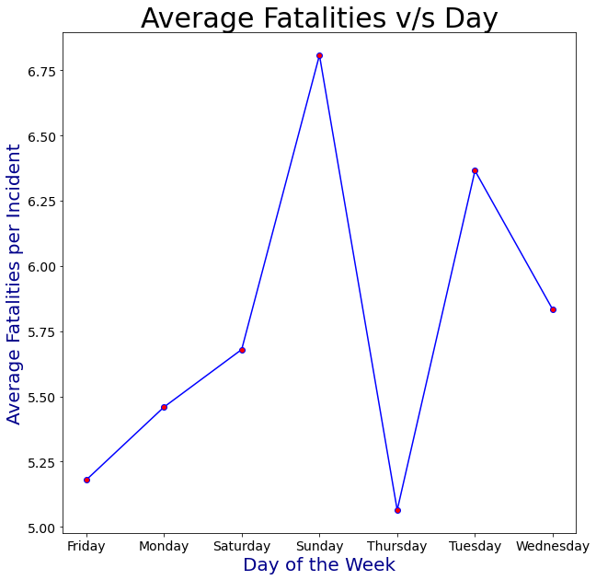
Average Fatalities V/S Day
Based on the type of Date of the Week, we have attempted to display the average number of fatalities per incident.
By examining this scatter plot, we can conclude that the average fatality occurs on the Sunday.

Slide 33
RESULTS AND DISCUSSION
The aircraft has a close proximity to the ground and is in a more vulnerable configuration than it would be in other phases of flight: the crew has to deal with a high workload and small maneuver margins during these phases.
It makes sense: Ice on wings, slippery runways, etc. are common during winter months. Are there other factors that contribute to the higher accident rate during the winter
There were many causes for Malaysia Airlines incidents, including bad weather, pilot errors, and mechanical failures.
There may be three main reasons why USAAF airliners crash:-Due to Training, Due to Human Error, Due to Ambush training

Slide 34
LIMITATIONS
In this project, we considered only a few of the Features. One could further work on the locations of the incidents and could find the hotspots.
Further one could judge whether these hotspots were static or changing over time.
We didn’t considered time of the incidents in our project as we couldn’t get proper and complete information about the time, which could be an important factor.
Also , we didn’t considered those Aircraft Operators in which Total Fatalities were less than 500. So, one could even try to find patterns under these.

Slide 35
CONCLUSION
When an aircraft's damage type is "DESTROYED," the number of fatalities is pretty high.
The fact that winters have a very high rate of accidents can be prevented by taking safety precautions like checking the wings and engine for ice, and properly cleaning the runways.
Often times, the reason for aircraft incidents is not only weather-related but human error as well, so aircraft companies need trained personnel to perform quality checks.
A military aircraft incident may occur during training or an ambush, but has fewer fatalities due to good emergency exits.

Slide 36
References
Data Sets:- https://www.kaggle.com
Pandas :-https://pandas.pydata.org/docs
Matplotlib :- https://matplotlib.org
Seaborn :- https://seaborn.pydata.org
Geeks For Geeks :- https://www.geeksforgeeks.org
Literature review 1:- https://www.researchgate.net/publication/318154819_Aviation_Accident_Analysis_A_Case_Study
Literature review 2 :- https://www.ijrte.org/wp-content/uploads/papers/v8i6s/F10270386S20.pdf
Literature review 3 :- https://www.ijeat.org/wp-content/uploads/papers/v9i3s/C10090393S20.pdf
Literature review 4 :- https://www.researchgate.net/publication/348429441_PIA_Accidents_Analysis_Using_Naive_Bayes_Classifier

